Slide 1

CHAPTER 3:
INFORMATION AGENCIES AND SERVICES

Slide 2







The learning outcomes of this chapter covering:
Libraries,
Archives,
Information centers,
Museums, and
Record centers
Typically encompass a range of knowledge, skills, and competencies related to these agencies.

Slide 3

INFORMATION AGENCIES
DEFINITION
Information agency can be defined as an organization which provides access to information.
Example: Libraries, Archives, Information centers, Museums, and Record centers.

Slide 4

TYPES OF INFORMATION AGENCIES
LIBRARY
INFORMATION CENTER
RECORD CENTER
01
02
03
04
04
ARCHIVE
MUSEUM

Slide 5
TYPES OF INFORMATION AGENCIES
LIBRARY
A collection of books and other literacy materials kept for reading, research, study and consultation.
A library is a collection of information, sources, resources and services, organized for use, and maintained by a public body, an institution, or a private individual. In the more traditional sense, it means a collection of books.

Slide 6
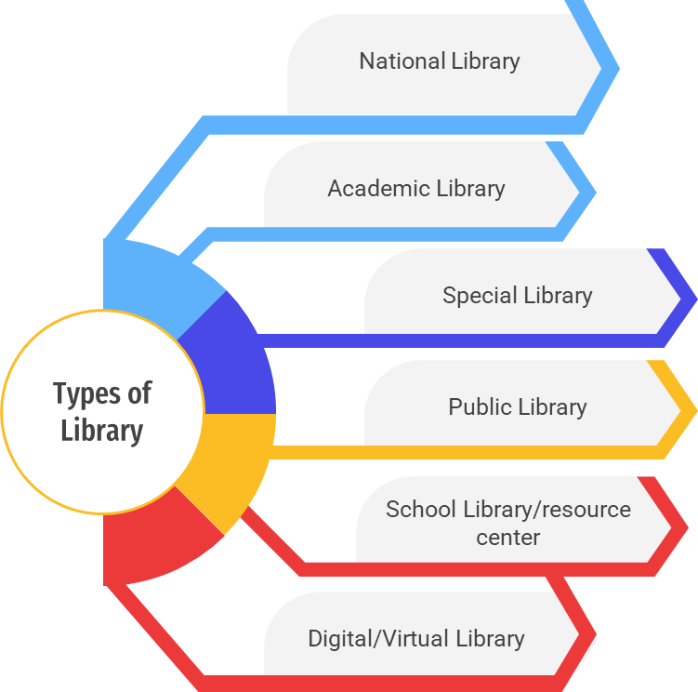
TYPES OF LIBRARY

Slide 7
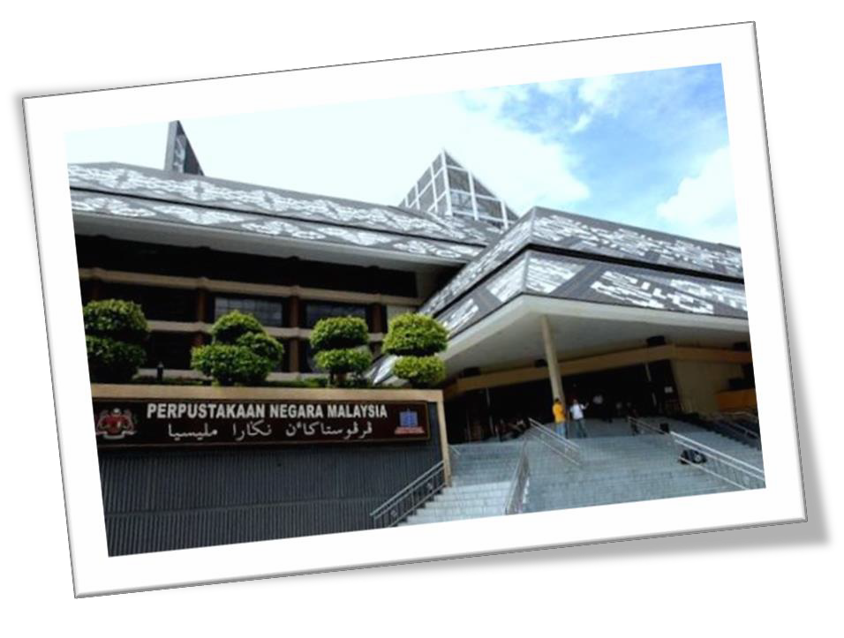

TYPES OF LIBRARY
National Library
A library maintain by government funds and serving the nation as a whole.
It is usually the country’s legal deposit library and collects and preserves the nation’s literature.
Example: Perpustakaan Negara Malaysia

Slide 8




National Library: 6 Functions
the collection via legal deposit of the national imprint (both print and electronic) and its cataloguing and preservation;
the provision of central services (e.g., reference, bibliography, preservation, lending) to users both directly and through other library and information centers;
the preservation and promotion of the national cultural heritage;

Slide 9



National Library: 6 Functions
acquisition of at least a representative collection of foreign publications;
leadership in national literacy campaigns
the promotion of national cultural policy;

Slide 10

Academic Library
An academic library is a library that is affiliated with an educational institution, typically a college, university, or research institution.
It serves the information needs of students, faculty, researchers, and staff associated with the institution.
Academic libraries play a crucial role in supporting teaching, learning, research, and scholarship within the academic community.
Example: Perpustakaan Tun Abdul Razak (UiTM), Perpustakaan Sultanah Zanariah (UTM), Perpustakaan Tun Seri Lanang (UKM).

Slide 11

Special Library
A library established and funded by a commercial firm, private association, government agency, nonprofit organization, or special interest group to meet the information needs of its employees, members, or staff in accordance with the organization's mission and goals.
Focus on providing information resources and services tailored to the unique requirements of their parent organizations or communities.
Example: SIRIM Library, RISDA Library, PETRONAS Library, ASTRO Library.

Slide 12
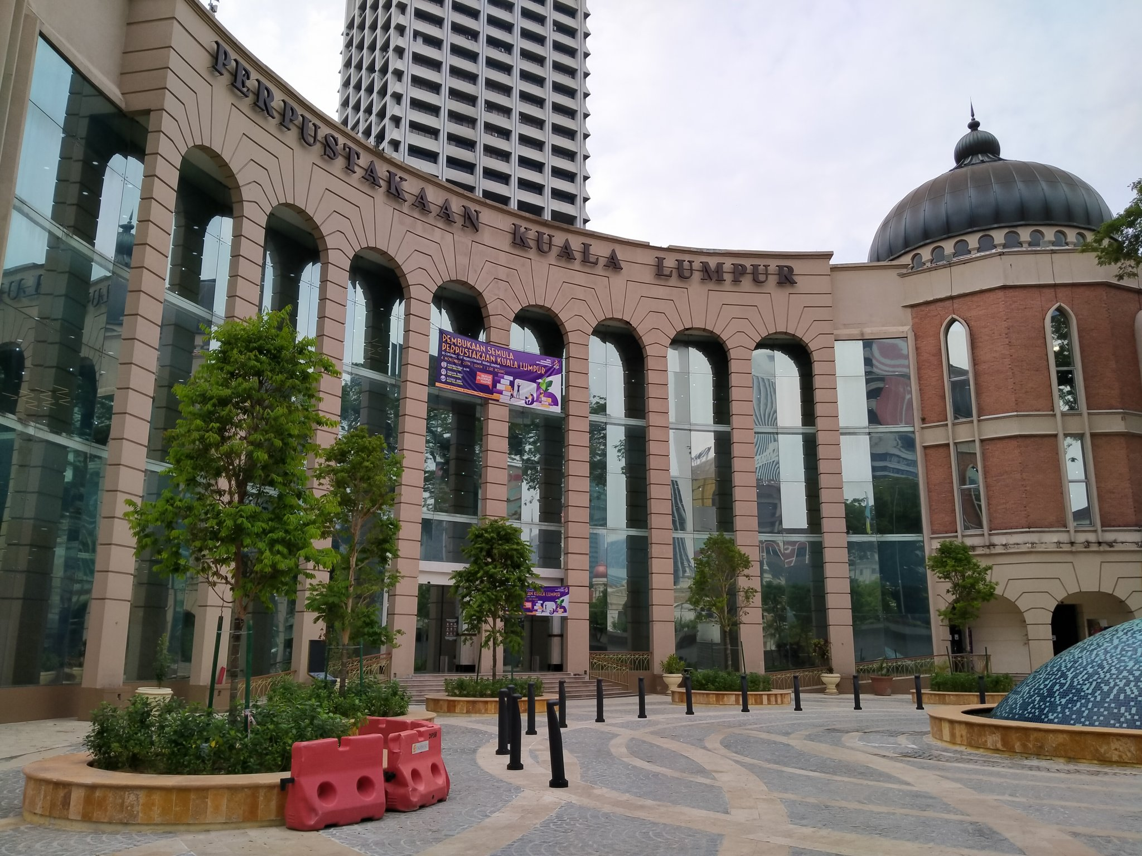

Public Library / State Library
Accessible to the general public and provides a wide range of resources, services, and programs to meet the educational, informational, cultural, and recreational needs of the community it serves.
Operated by local governments, library districts, or municipal authorities.
Examples: Sarawak State Library, Johor State Library.

Slide 13

School Library / Resource Center
A library in a public or private elementary or secondary school that serves the information needs of its students and the curriculum needs of its teachers and staff, usually managed by a school librarian or media specialist.
A school library collection usually contains books, periodicals, and educational media suitable for the grade levels served.
Example: Pusat Sumber SMK Kuala Kurau, Perak,
International School of Kuala Lumpur Resource Center.

Slide 14

Digital Library
Digital libraries are the digital face of traditional libraries that include both digital collections and traditional, fixed media collections.
It encompass both electronic and paper materials.
The digital content may be locally held or accessed remotely via computer networks.

Slide 15


TYPES OF INFORMATION AGENCIES
ARCHIVE
A place holding a collection of historical records on a topic, also the collection itself.
Ranging from papers and documents (includes manuscript) to films, videotapes and sound recording are preserved store and managed.

Slide 16
TYPES OF INFORMATION AGENCIES
ARCHIVE
3. The building, facility, or area that houses an archival collection(the term repository is preferred by most archivists). Also, to place documents in storage, usually to preserve them as a historical, informational, legal, or evidential record, permanently or for a finite or indefinite period of time.

Slide 17
TYPES OF INFORMATION AGENCIES
ARCHIVAL MATERIALS
Archival materials comprise all forms acquired from both official as well as private sources.
Materials acquired from government departments include files, publications, acts and ordinances, photographs, microfilms, audio-visual materials, treaties, oral history recordings, maps, plans etc.
Materials from private sources include collection of private papers which may contain government papers, photographs, theses, and newspapers.

Slide 18
TYPES OF INFORMATION AGENCIES
INFORMATION CENTER
An organizational unit with the mission to support users in exploiting information technology and provide information required by the users for their knowledge or reference.
A place where people can get any information for their knowledge or reference.
Example is the “Pusat Maklumat Rakyat” under the administration of the Department of Information, Ministry of Information, Communication, and Culture of Malaysia.

Slide 19
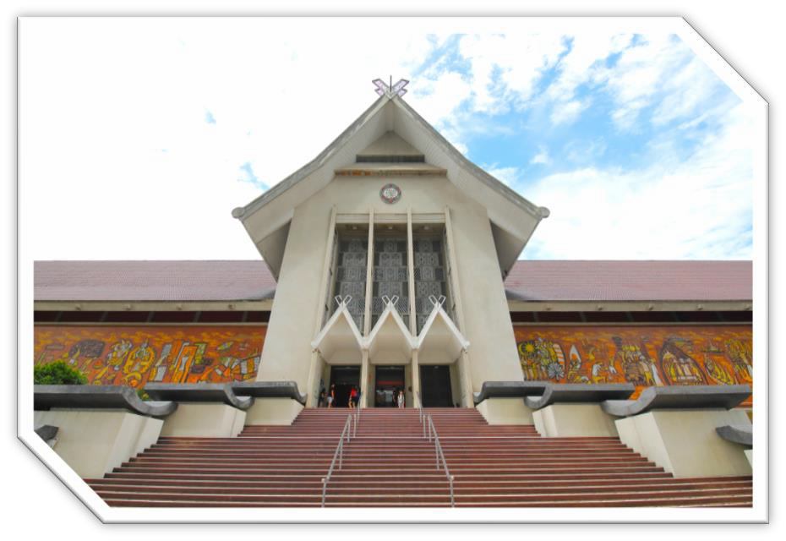
TYPES OF INFORMATION AGENCIES
MUSEUM
1. The International Council of Museum define museum as:
”A museum is a nonprofit making, permanent institution in the service of society and its development and open to the public, which acquires, conserves, researches, communicates and exhibits, for purposes of study, education and enjoyment, material evidence of people and their environment.”

Slide 20
TYPES OF INFORMATION AGENCIES
MUSEUM
2. A building, place or institutions devoted to acquisition, conservation, study, exhibit. An interpretation of objects having scientific, historical or artistic value. A museum is a nonprofit, permanent institution in the service of society.

Slide 21
TYPES OF INFORMATION AGENCIES
MUSEUM
3. “Museums enable people to explore collections for inspiration, learning and enjoyment. They are institutions that collect, safeguard and make accessible artifacts and specimens, which they hold in trust for society.” (Museums Association, 1998)

Slide 22
TYPES OF INFORMATION AGENCIES
RECORD CENTER
A building or part of a building designed or adapted for the low-cost storage, maintenance and communication of semi- current records pending their ultimate disposal.
It is also a service intermediate between the records offices of operational agencies and the archival institution.

Slide 23
FUNCTIONS & ROLES OF INFORMATION AGENCIES
Function: Function refers to the natural purpose of something or the duty of a person.
Role: Role is a part played by someone in a particular situation.

Slide 24
FUNCTIONS OF INFORMATION AGENCIES
LIBRARY
To acquire, store and preserve printed and non printed materials for reference purpose
Selecting and organizing a comprehensive information collection to cater for the library patron’s need
To assist the user to access information fast and accurate

Slide 25
FUNCTIONS OF INFORMATION AGENCIES
ARCHIVE
Identify, appraise, preserve and make available documentary materials that are of value to the organization/ public.
Ensure accountability of government
Disseminate knowledge and information of historical value among the public

Slide 26
FUNCTIONS OF INFORMATION AGENCIES
ARCHIVE
Preserve records for the benefits of the scholar and posterity (future
generation)
National Archive should be the most accurate and authentic
information resource center in any country.
To popularize the use of archival materials through exhibitions, publications and modern technology

Slide 27
FUNCTIONS OF INFORMATION AGENCIES
ARCHIVE
Disseminate knowledge and information of historical value among the public.
Protect documented and recorded national history.

Slide 28
FUNCTIONS OF INFORMATION AGENCIES
INFORMATION CENTER
An information center is a center designed specifically for storing, processing, and retrieving information for dissemination at regular intervals, on demand or selectively, according to express needs of users

Slide 29
FUNCTIONS OF INFORMATION AGENCIES
INFORMATION CENTER
Provide accurate information about the functions of all government departments and agencies to the public.
Provide information about government policies.
Provide counter service, online service, and other form of information access service
Provide adequate and satisfactory reference information center
Entertain complaints and inquiries by providing accurate and current information.

Slide 30
FUNCTIONS OF INFORMATION AGENCIES
MUSEUM
Museums collect and care for objects of scientific, artistic, or historical importance and make them available for public viewing through exhibits that may be permanent or temporary.

Slide 31
FUNCTIONS OF INFORMATION AGENCIES
MUSEUM
To collect objects and materials of cultural, religious and historical importance to a nation;
To organize (or classify), preserve them, and research into them;
To display and present them to the public for the purpose of education and enjoyment;
To encourage, promote and foster the best of the cultural and democratic ideals of the nations; and
To project a sense of the nation.

Slide 32
FUNCTIONS OF INFORMATION AGENCIES
RECORD CENTER
To hold semi-current records and make available for use until the date of their disposal.
Provides a general service to all parts of the government or corporation. It is also a service intermediate between the records offices of operational agencies and the archival institution.
To manage and to make available current records for office use when needed.

Slide 33
ROLES OF INFORMATION AGENCIES

Slide 34
ROLES OF INFORMATION AGENCIES
ARCHIVE
Identify, appraise, preserve and make available documentary materials that are of value to the organization/ public.
2. Ensure accountability of government which preserve public records and made them available as legally and ethically appropriate.

Slide 35
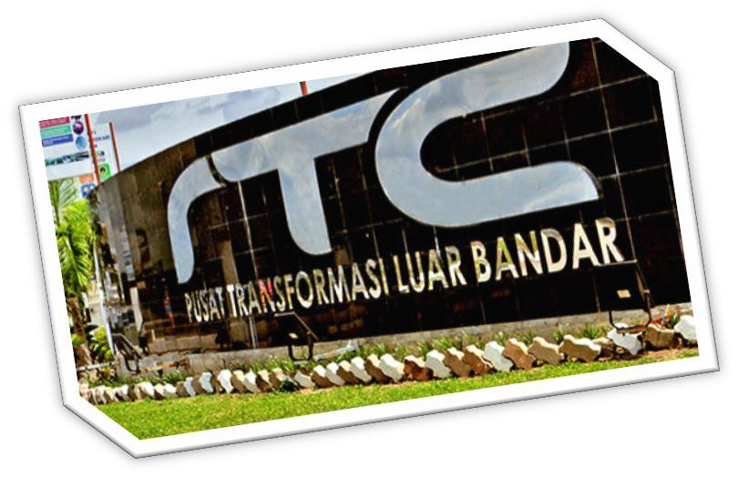
ROLES OF INFORMATION AGENCIES
INFORMATION CENTER
To provide information and information resources in a particular or specific area of interest for the consumers relating to its parent organization or according to its subject specialization.
As a mean of supporting the parent organization or government’s effort in creating awareness on a particular area of interest among the public.
Provides advice and guidance on a particular subject or area usually required by the public.

Slide 36
ROLES OF INFORMATION AGENCIES
LIBRARY
As a community information center
The library is an informal channel for - information and assistance for current information on community, services and issues
As a source of information about community services
Participate in community referral networks, may have calendar of community events.

Slide 37
ROLES OF INFORMATION AGENCIES
LIBRARY
Popular materials center
It features current, high demand, high interest materials in variety formats for all ages.
Lifelong learning
Encourages children to develop interest in reading and learning through services for children

Slide 38
ROLES OF INFORMATION AGENCIES
LIBRARY
Service oriented information provider
It provides timely, accurate and useful information for community
It promotes on site, online and telephone reference services to aid users
Interlibrary loan and cooperative reference services

Slide 39
ROLES OF INFORMATION AGENCIES
MUSEUM
Repositories for the vast products of nature and the impressive accomplished of humanity.
Educational institutions for people of all ages.
Public gathering places where visitors can be entertained, inspired and exposed new verification of ideas.
Benefits a sources of national, regional and local identity.

Slide 40
TYPES OF USER SERVICES IN INFORMATION AGENCIES
User services in information agencies refer to the range of services and support provided to users or patrons to help them access and utilize information resources effectively.
These services are aimed at meeting the information needs of users, enhancing their experience, and facilitating their use of library materials, facilities, and technologies.

Slide 41
TYPES OF USER SERVICES IN INFORMATION AGENCIES
ARCHIVE
Exhibition Gallery of Archives
Depositing Records with the Archive Service
Reference Services
Advisory Service
Training
Public talks, Conference, Forum

Slide 42
TYPES OF USER SERVICES IN INFORMATION AGENCIES
INFORMATION CENTER
Information Kiosk / Counter
Internet Access
Outreach Programs
Dissemination of Information via Website and publications
Referral and Advisory Service

Slide 43
TYPES OF USER SERVICES IN INFORMATION AGENCIES
LIBRARY
Among the names or terms used to describe library user services are:
Information services
Learning services
Advice services
Leisure services

Slide 44
TYPES OF USER SERVICES IN INFORMATION AGENCIES
LIBRARY
Among the names or terms used to describe library user services are:
Reference Services:
Reader Advisory Service
Information Packaging Services
Audio Visual Services
Special Collections
Reference Research Service

Slide 45
TYPES OF USER SERVICES IN INFORMATION AGENCIES
LIBRARY
Among the names or terms used to describe library user services are: (continued)
Circulation Services; Loan & Reservation
Documentation Service
Digital Service
Membership Registration
Carrel Room Service
Photocopy Service (Reprographic Service)

Slide 46
TYPES OF USER SERVICES IN INFORMATION AGENCIES
LIBRARY
Among the names or terms used to describe library user services are: (continued)
Information Literacy Movement
User Education Session
Community Information Services
Online Membership Application

Slide 47
TYPES OF USER SERVICES IN INFORMATION AGENCIES
MUSEUM
Exhibition
Research and Education
Advisory Service
Guided Tours
Outreach programs

Slide 48
TYPES OF USER SERVICES IN INFORMATION AGENCIES
RECORD CENTER
Storage
Transfer of Records
Retrieval / Reference Service
Record Disposition
Advisory Service
Imaging and Digitization Service

Slide 49
TUTORIAL
In a group of 3-4 persons:
Compare the functions and roles of public libraries and academic libraries by highlighting four (4) key differences.
State the distinction between an archive and archival material.

Slide 50
Thank You!

